Slide 1
The Michigan Genomics Initiative (MGI): An Integrated Data Frame to Enable Precision Health Queries (An incredible in-house resource)
Bhramar Mukherjee
Workshop on Computational Biostatistics
and Survival Analysis, Mumbai

Slide 2




Acknowledgements
Lars Fritsche
Maxwell Salvatore
Lauren Beesley
Matt Zawistowski

Slide 3
Outline
Part 1: Infrastructure: What type of data, who are in this study?
Part 2: Examples: Phenome-wide Association Studies
Part 3: Promises and Perils: Using electronic health records or non-probabilistic samples for research?

Slide 4
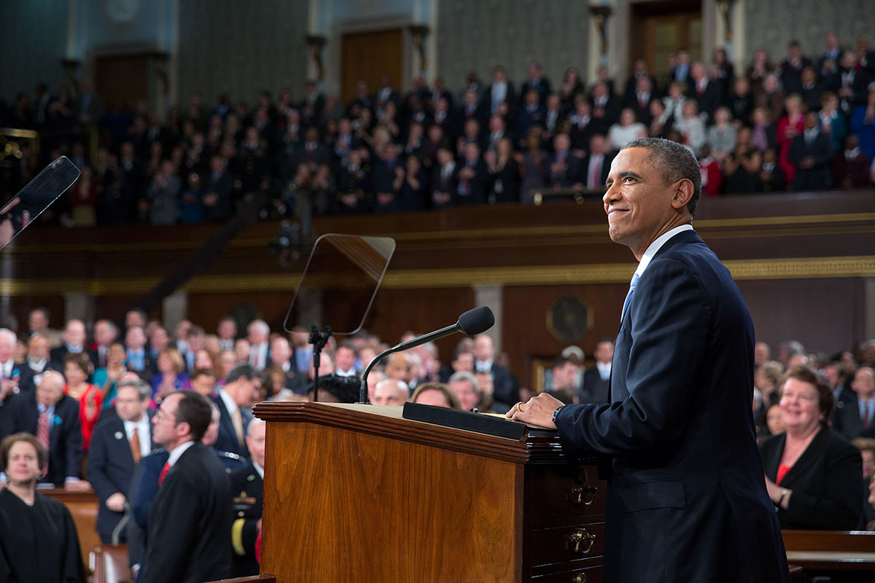
Precision Medicine Initiative of the White House
“Tonight, I'm launching a new Precision Medicine Initiative to bring us closer to curing diseases like cancer and diabetes and to give all of us access to the personalized information we need to keep ourselves and our families healthier.”
-President Barack Obama
State of the Union Address,
January 20, 2015

Slide 5

Collins and Varmus (NEJM, 2015)
“The prospect of applying the concept of personalized medicine broadly has been dramatically improved by the recent development of large-scale biologic databases (such as the human genome sequence), powerful methods for characterizing patients (such as proteomics, metabolomics, genomics, diverse cellular assays, and even mobile health technology), and computational tools for analyzing large sets of data. ”

Slide 6

Part 1: Infrastructure
A cross campus initiative supported by the Provost’s office and several schools
Create data resources that serve as an accelerator and incubator for interdisciplinary health research, enriching ongoing activities and sponsoring new efforts

Slide 7
Michigan Genomics Initiative (MGI)
A longitudinal study of Michigan Medicine patients
Consented to linkage of clinical health data to biospecimen samples for research purposes
Initial recruitment began in 2012 as part of Anesthesiology Study of Pain Outcomes
Biospecimens collected from Michigan Medicine surgery patients
Electronic Health Information

Slide 8











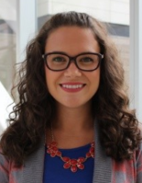



Stewards of the Data
Biostatistics Team (Genetic Data)
Data Direct (Clinical Data)
Precision Health
Central Biorepository
Notes:
Interdisciplinary team. Key of good data management is having team with strong complementary skill sets.

Slide 9
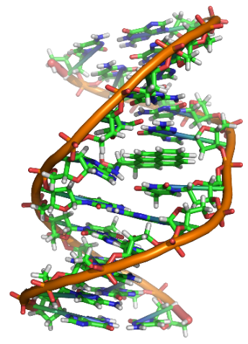
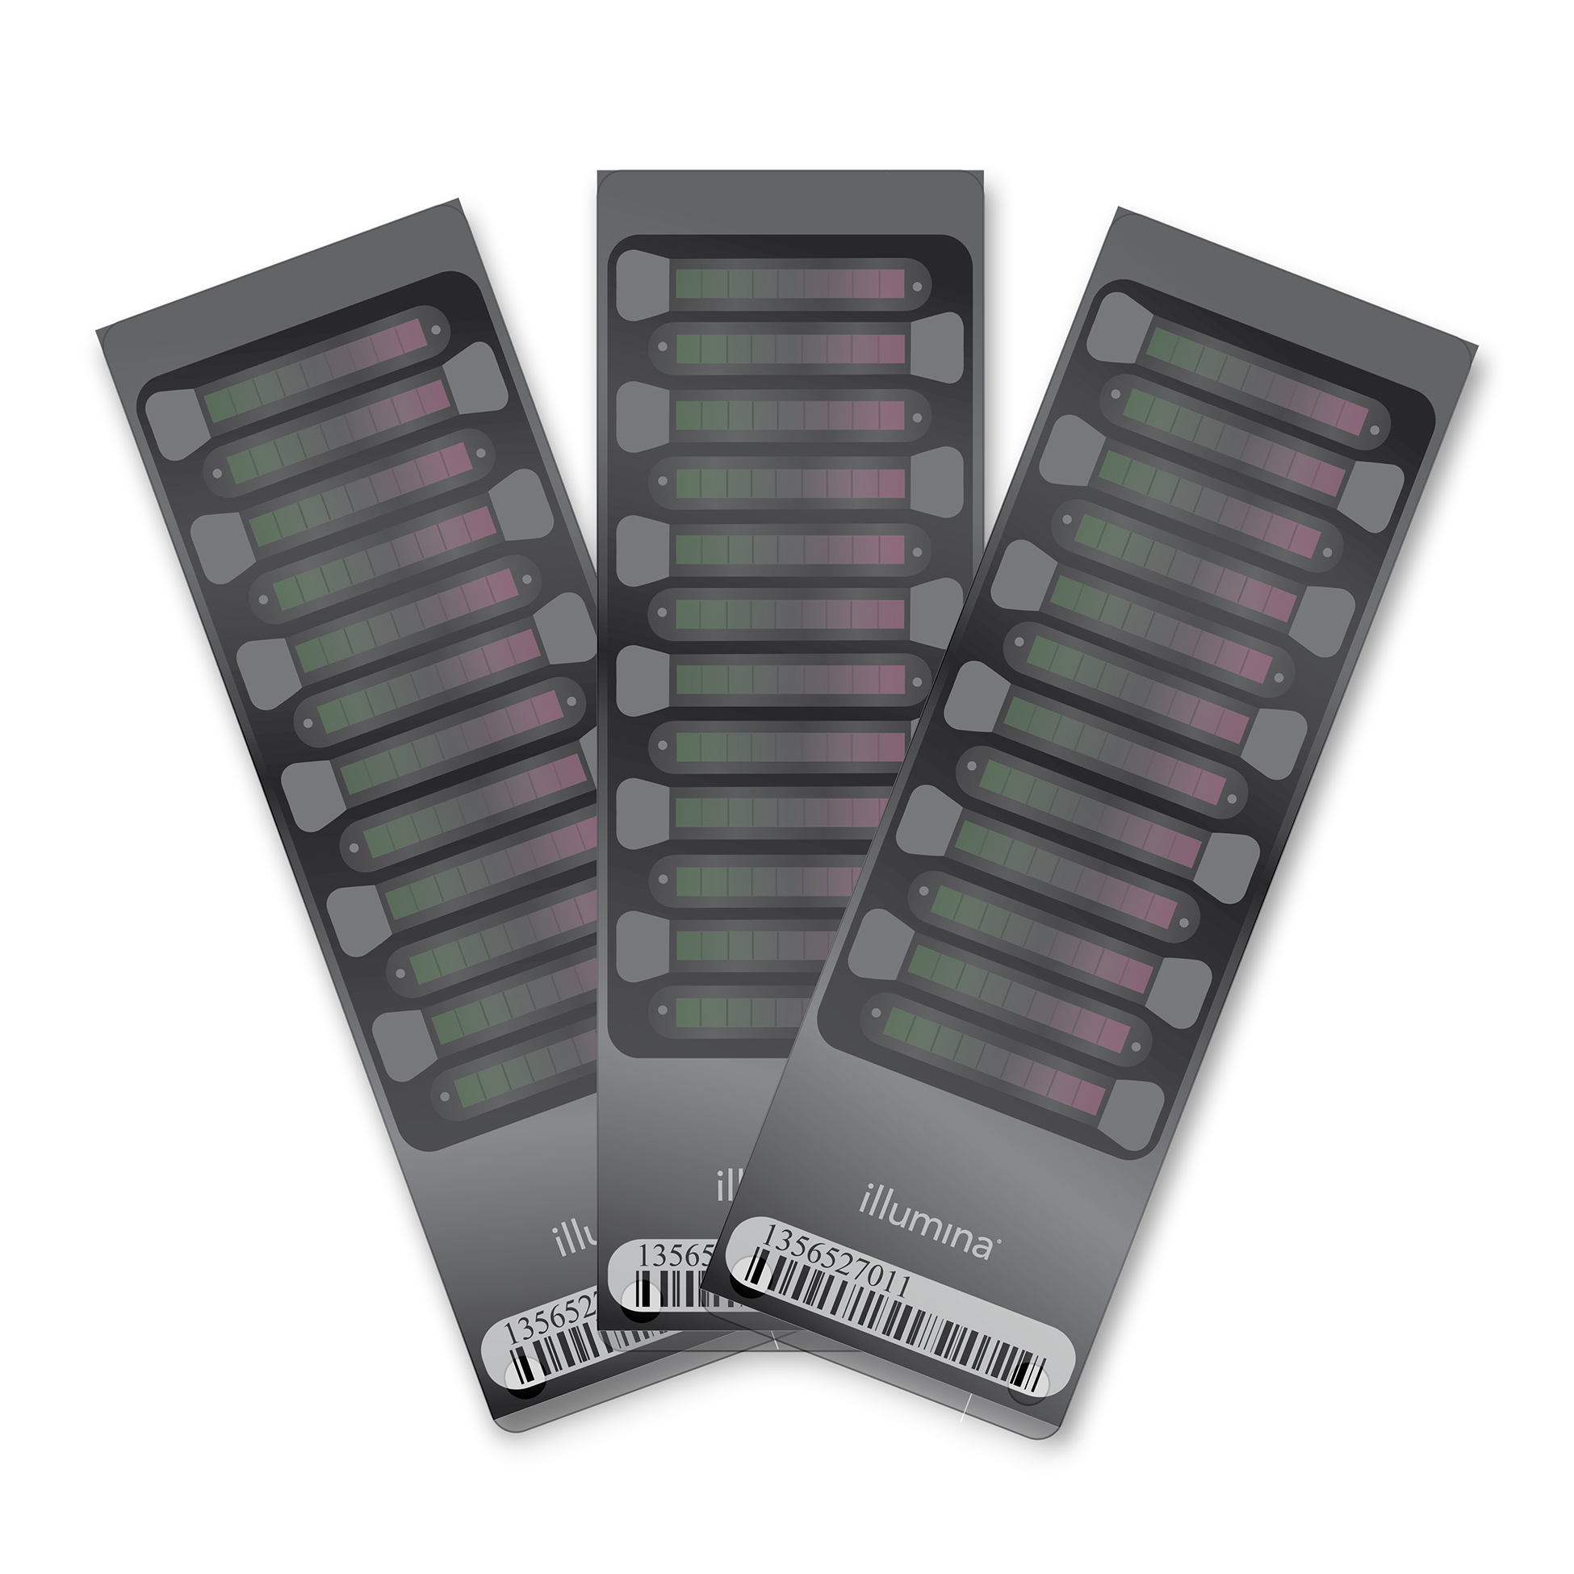


MGI Genetic Data
Blood sample taken during consent
UM Sequencing Core Genotyped for ~500K SNPs on Illumina HumanExomeCore
and initial QC
Central Biorepository (CBR) for biobanking
Accessible for future research
Biostatistics Team
Extensive genotype QC
Genotype Imputation to >20M SNPs
Provide access and analytic support

Slide 10
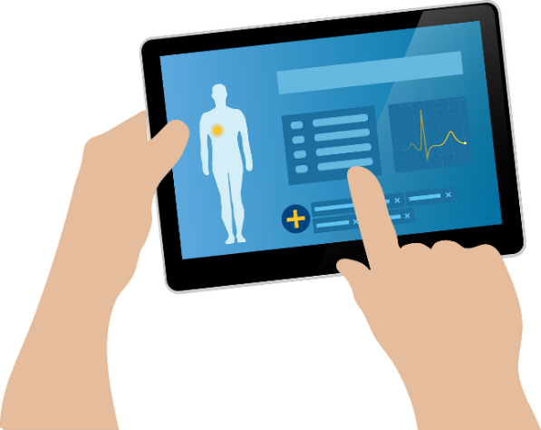
MGI Clinical Data
Electronic Health Records (EHRs) are a digitized version of a patient medical chart
Health Care Systems routinely capture various pieces of patient health and treatment history
“Administrative data” such as diagnoses, procedures, lab results, prescriptions are primarily stored for billing purposes and record keeping, used in the analysis of hospital resources and quality metrics
EHRs are health system-specific
EHRs are a historical record of health and treatment, not primarily research oriented, but they can be queried

Slide 11
MGI is BIG Data
Medical Phenotype
Genetics
>16 million medical encounters with Michigan Medicine
>20 million genetic variants per sample
Patient
65,000 consented samples (5/2019)
Notes:
Adopting a new terminology for the program – Precision Health – we are actively seeking to use a wider “phenotype” to describe the individual. We know intuitively that social, environmental and behavioral factors can have as much or more impact on disease manifestation in an individual. However, with the ability to amass and process much larger data sets, electronic health records that can be adapted to contain more nuanced information and advances in implementation science, healthcare providers have an unprecedented opportunity to take this knowledge and, in partnership with their patients, make Precision Health a reality.
In addition to the traditional strengths in medicine, engineering, pharmacy and public health, researchers with expertise across the campus from the schools of social work and natural sciences to ISR researchers can engage and build a richer program.

Slide 12
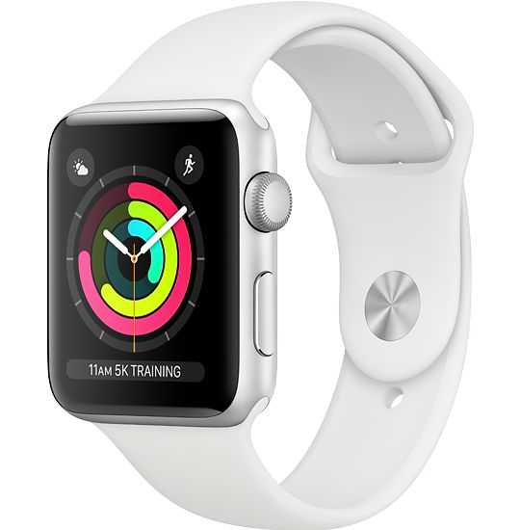
And getting BIGGER
Medical Phenotype
Genetics
Behavior/Lifestyle
Patient
Family History
MIPACT
Environmental
Social
Notes:
Adopting a new terminology for the program – Precision Health – we are actively seeking to use a wider “phenotype” to describe the individual. We know intuitively that social, environmental and behavioral factors can have as much or more impact on disease manifestation in an individual. However, with the ability to amass and process much larger data sets, electronic health records that can be adapted to contain more nuanced information and advances in implementation science, healthcare providers have an unprecedented opportunity to take this knowledge and, in partnership with their patients, make Precision Health a reality.
In addition to the traditional strengths in medicine, engineering, pharmacy and public health, researchers with expertise across the campus from the schools of social work and natural sciences to ISR researchers can engage and build a richer program.

Slide 13

Cohort Development Working Group
Michigan Genomics Initiative Current Enrollment
64,000 patients enrolled with 59,000 samples
Enrollment continues at ~ 10,000/yr.
93% in perioperative or cardiac procedures units
5% in Endocrinology outpatient units (MGI-MEND)
2% in Mental Health outpatient units (MHB2)
<1% new protocols/sites
Consent includes permission to re-contact and link data
Cristen Willer
Lynda Lisabeth
13

Slide 14
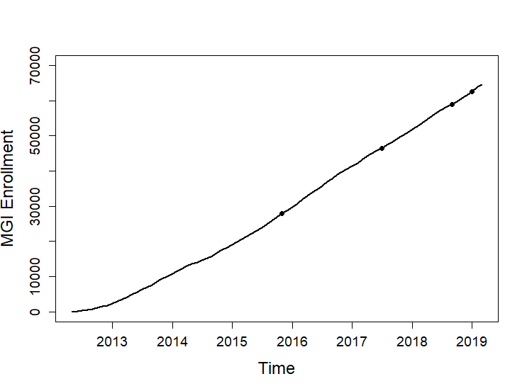
MGI: Steady recruitment across years
BIGBIRD
MHB
MIPACT
MEND

Slide 15
Biobanks around the world
NIH All of Us Cohort: https://allofus.nih.gov/ Lifestyle, Environment and Biology
Beesley et al, Under Review, 2019a

Slide 16
Envisioned Data Eco System
ADDITIONAL INTERNAL LINKABLE
Michigan Medicine EMR (Imaging, Some Lab Results)
UM Tumor Registry
Michigan Dental Records
ACQUIRE
Prescription claims (AllScript RX)
Truven MarketScan (IHPI)
State Death Records
ALREADY HAVE
Michigan Medicine EMR (Structured and Unstructured)
MGI Genomics
Epidemiologic Survey (Mukherjee)
PROMIS Surveys (Brummett)
UM Cancer Registry
PUBLICLY AVAILABLE DATA LINKABLE TO RESIDENTIAL LOCATION
Air Quality (EPA)
Pollen Counts (NOAA)
National/Statewide cancer registries
Census (education, income, home ownership, home age, rural/urban)
Crime Rate (DOJ)
Behavior and Risk Factor Surveillance System (BRFSS)
POTENTIAL EXTERNAL LINKABLE*
Claims (Blue Cross Blue Shield)
National Death Index
Outpatient EMR
Abbreviations: DOJ, Department of Justice; EMR, electronic medical record; EPA, Environmental Protection Agency; NOAA, National Oceanic and Atmospheric Administration

Slide 17



MGI EPI-Q: The Development Process
Epidemiologic questionnaire
+
EHR
=
Makes us stand out
Begin with UK Biobank survey
Positions MGI to participate in large meta-analyses
Review other US-based biobank surveys:
All of Us
Million Veterans Program
Genes for Good

Slide 18
MGI EPI-Q baseline architecture
MGI EPI-Q Baseline
Alcohol
Anxiety
Cancer
Cardiovascular disease
Demographics
Depression
Diabetes
Emotion
Employment
Family
Health
Hearing
Life satisfaction
Men’s health
Phenotypic traits
Phenotypic traits
Physical activity
Sexual history
Sleep
Smoking
Social activity
Sun (exposure)
Women’s health
Personal site history
Treatment
Family history
Cancer
MGI-EPIQ
(Mukherjee)
Mental Health
MHB/MEND
(Sen/Burant)
Pain
AOS/oPIOIDS
(Brummett)

Slide 19
MGI EPI-Q optional module architecture
Access to Healthcare and utilization
Alcohol
Depression
Diet
And
Eating habits
Life satisfaction
and
Anxiety/(Stress?)
Pain
Physical activity
Substance use/abuse
Vision
Occupational Exposure
Purpose and well being

Slide 20
Vision 2020
A rich dataset with large n and large p
Different lenses to explore agnostically or in hypothesis driven ways
Contribute to biobank meta-analysis
A shared resource for the institution

Slide 21







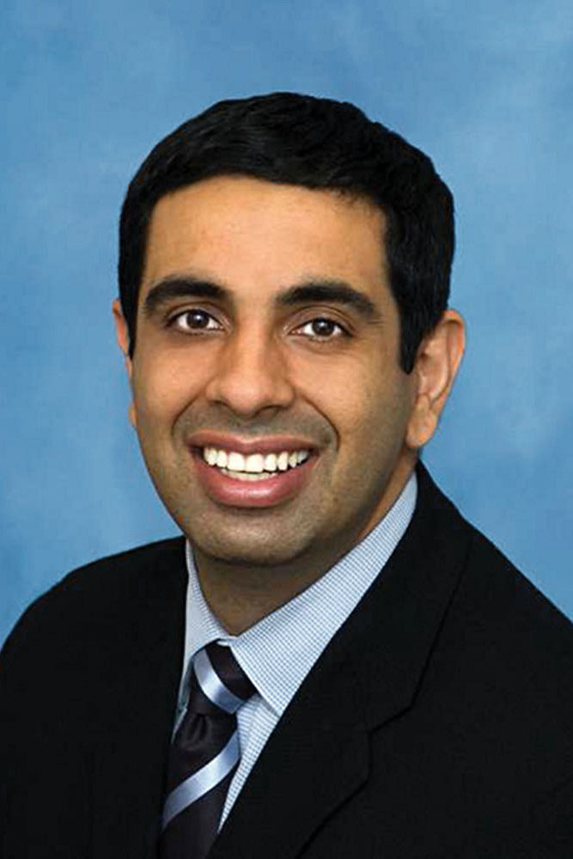





Part 2: Research Story
Lars Fritsche
Gonçalo Abecasis
Ellen Schmidt
Zhenke Wu
Matthew Zawistowski
Chad Brummett
Victoria Blanc
Sachin Kheterpal
Stephanie Moser
Stephen Gruber
Fritsche et al, AJHG, 2018
Fritsche and Beesley et al, 2019

Slide 22
Biased Convenience Sampling in MGI
Recruited through anesthesiology
Prior to diagnostic or interventional procedure
Rapid accrual, enriched for cancer (47%)
 | Total 2012-18
Approached | 76,313
Consented | 56,753
Declined | 19,560
Biosample acquired | 52,324
Genotyped | 49,214
EHR data integrated | 48,995
Notes:
Why is it enriched for cancer, it could be cancer patients have more procedures or they choose to come to academic medical centers for diagnostic and interventional procedures…

Slide 23
Demographics and Clinical Characteristics
Characteristic | Analytic Data Set
N | 38,177
Females, N (%) | 20,032 (52.5%)
Mean Age, years (S.D.) | 56.4 (16.2)
Median number of visits per participant | 27
Median time between first and last visit | 4.9 years
Median number of distinct ICD* codes per participant | 31
*ICD (international Classification of Disease Codes)

Slide 24
Data Processing: Phenome-wide Association Studies (PheWAS)
Michigan Medicine
Central Biorepository
Array Genotyping
EHR
ICD-9/10 Codes
Lab data
Imputation
Computable
Phenotype
Principal Components
Age & sex information
Matching

Slide 25
Preparing the Phenome
Denny et al. , 2010, 2013
Diagnoses describing same phenotype
Cases
Case - control study
per “PheWAS Code”
Potentially similar diagnoses. Patients with these should not be used as controls
Controls
…
Thousands of unrelated diagnoses

Slide 26
Crude Data Reduction
ICD Code Days
5.9 million
Unique ICD codes
27,580
PheWAS Codes with > 50 Cases
1,653

Slide 27

Phenome-wide Association Studies (PheWAS)
Visualization Tool: http://pheweb.sph.umich.edu/
Phenome-wide significance:
=0.05 / 1,653
= 2.9 x 10⁻⁵
1653 Synthetic Case Control Studies
Basic Association Model logit$P\left(D=1 | G, Z\right)=θ_{0}+θ_{G}G+θ_{z}^{⊤}Z$

Slide 28
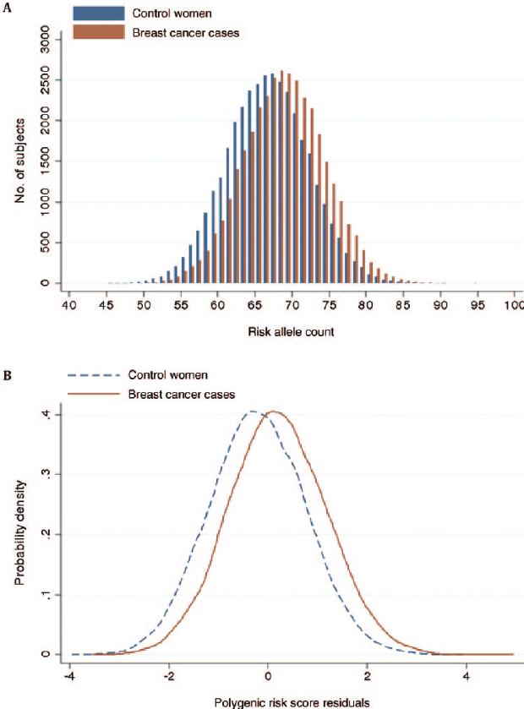
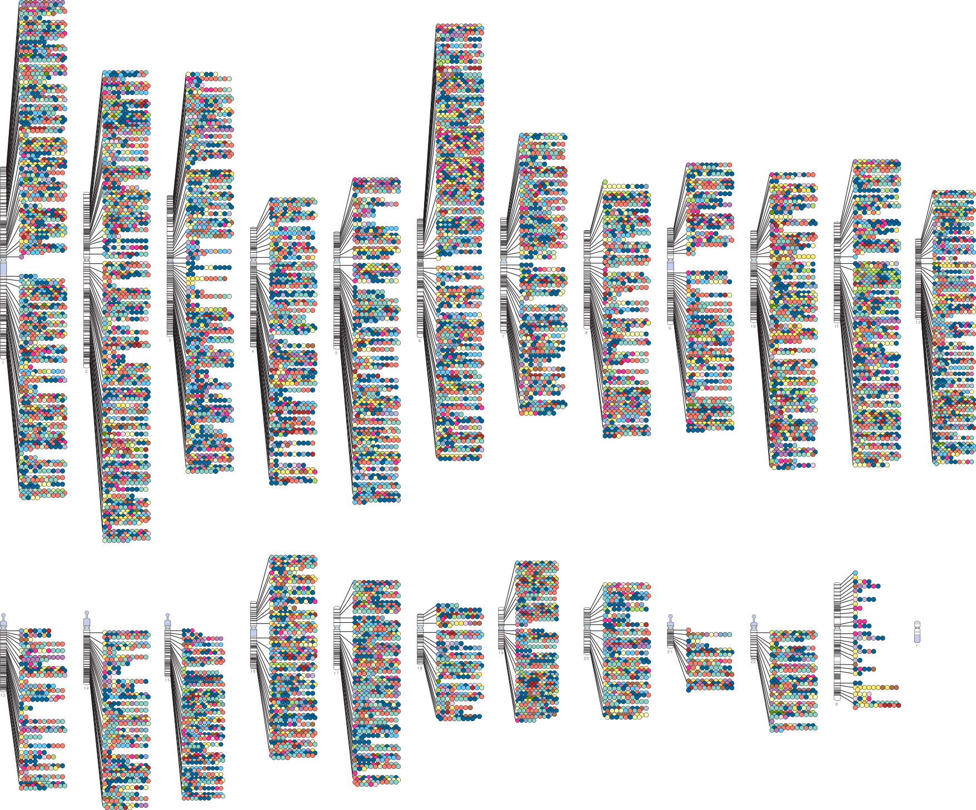
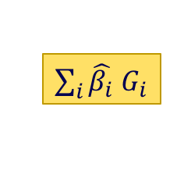
Exploration of Cancer Traits
Curate Effect Sizes and SNP list from published GWAS
Polygenic Risk Scores (PRS)
PRS Phenome-wide Association Study (PheWAS)
NHGRI-EBI GWAS Catalog
Broad European Ancestry
Quality control & LD pruning
Effect size weighting
Firth's bias corrected
logistic regression
$\sum_{i}{\hat{β_{i}}}$ $G_{i}$

Slide 29
16 Cancer Traits in MGI (with ≥ 250 Cases and ≥ 5 independent GWAS Catalog SNPs)
Cancer Trait / Site | N Cases | N Controls | N SNPs In PRS | Enrichment Quartile 4 versus 1
 |  |  |  | OR [95% CI] | P
Breast [female] | 2,367 | 14,610 | 91 | 2.4 (2.1-2.7) | 2.62E-37
Melanomas of skin | 2,361 | 31,552 | 18 | 2.6 (2.3-3.0) | 6.24E-48
Prostate | 2,142 | 13,106 | 108 | 2.8 (2.5-3.3) | 2.53E-44
Basal cell carcinoma | 2,050 | 31,552 | 31 | 3.0 (2.6-3.4) | 7.97E-49
Bladder | 1,461 | 35,896 | 13 | 1.7 (1.4-2.0) | 5.67E-11
Squamous cell carcinoma | 1,411 | 31,552 | 11 | 2.2 (1.9-2.6) | 3.04E-22
Non-Hodgkins lymphoma | 1,034 | 36,267 | 13 | 1.5 (1.2-1.8) | 4.89E-05
Colorectal | 1,015 | 29,395 | 18 | 1.5 (1.2-1.8) | 5.23E-05
Part 1

Slide 30
Rest of the list and PRSWeb
Cancer Trait / Site | N Cases | N Controls | N SNPs In PRS | Enrichment Quartile 4 versus 1
 |  |  |  | OR [95% CI] | P
Kidney, except pelvis | 997 | 35,896 | 13 | 1.1 (0.8-1.6) | 0.282
Bronchus / lung | 771 | 37,319 | 23 | 1.3 (1.1-1.7) | 0.0108
Thyroid | 730 | 35,425 | 13 | 3.3 (2.6-4.3) | 3.61E-23
Uterus | 577 | 13,930 | 13 | 1.4 (1.1-1.8) | 0.00352
Brain and nervous system | 510 | 36,344 | 20 | 1.4 (1.1-1.8) | 0.0185
Brain | 418 | 36,344 | 11 | 1.5 (1.2-2.0) | 0.0027
Pancreatic | 394 | 28,876 | 15 | 1.5 (1.3-1.7) | 0.00502
Ovary | 320 | 14,804 | 19 | 1.1 (0.8-1.6) | 0.431
PRSWeb: Making Data Accessible
Part 2
prsweb.sph.umich.edu

Slide 31
Squamous Cell Carcinoma PheWAS
Association with Squamous Cell Carcinoma PRS (5 Risk SNPs)
Notes:
In our second example we again found strong association with the PRS with its primary cancer trait but also strong association with other skin cancer traits like melanoma and basal cell carcinoma. This has probably to do with known genetic risk factors that are shared between the skin cancer traits.
In addition we found PRS association with dermatologic traits, like actinic keratosis and dermatitis due to solar radiation.
And again we asked the question: are these potential pre-cancer phenotypes, phenotypes with shared genetic risks with squamous cell carcinoma, or biased findings from an intensified screening of individuals that had a skin cancer diagnosis once in their life time.

Slide 32
Exploring the Temporal Order

Slide 33
Striking Reproducibility in betasll Carcinoma

Slide 34
Questions after the first paper
Why is a biased/enriched sample giving results nearly identical to population-based GWAS? [Selection Process into MGI]
Different people have different length of stay in their EHR, how does that affect our “capture rate” of true disease states? [Disease Classification/Phenotyping]

Slide 35
Part 3: Perils and Promises of Big Data Gartners Hype Cycle
Notes:
AI, Augmented analytics, blockchain, quantum computing

Slide 36
Stat 101 Fundamental Questions
Who is in my study?
What is the target population of inference?

Slide 37

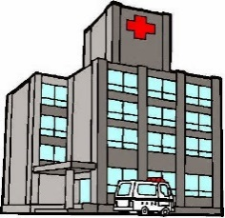
Defining Disease Status using ICD Codes
Observation Window Bias
?
?
?
t₀
t₁
Diagnosis Code 1
Diagnosis Code 2
Diagnosis Code 4
Diagnosis Code 1
Diagnosis Code 2
Diagnosis Code 1
Diagnosis Code 3
Subject | Days Alive at Visit | Diagnosis
1 | 22000 | 1
1 | 22000 | 2
1 | 22050 | 1
1 | 22050 | 3
Data
Structure

Slide 38
Snapshot of existing solutions
“Fancier” phenotyping
Natural language processing
Human validation
Relate model for misclassified and true outcomes (e.g. Duffy 2004, Sinnott 2019)
Integrate out unknown sensitivity/specificity incorporating existing information (e.g. Huang 2018)
Other work in measurement error literature
Sensitivity (True Positive), Specificity (True Negative) may also depend on covariates

Slide 39
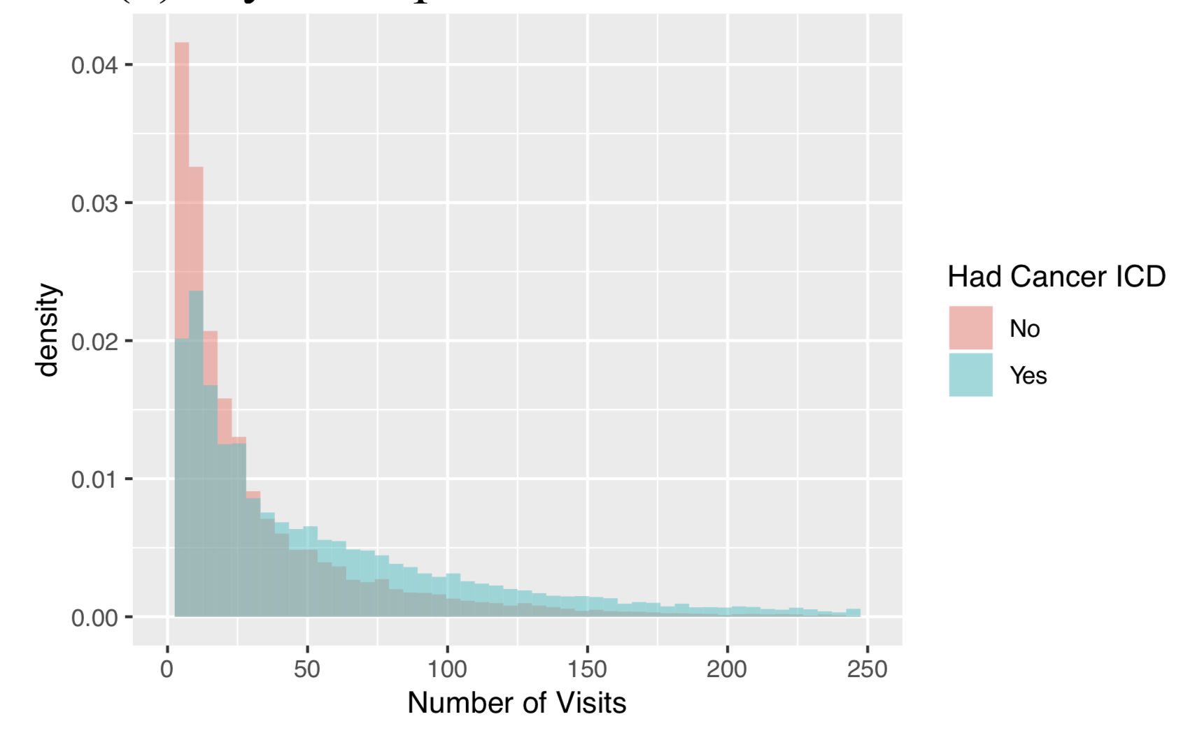
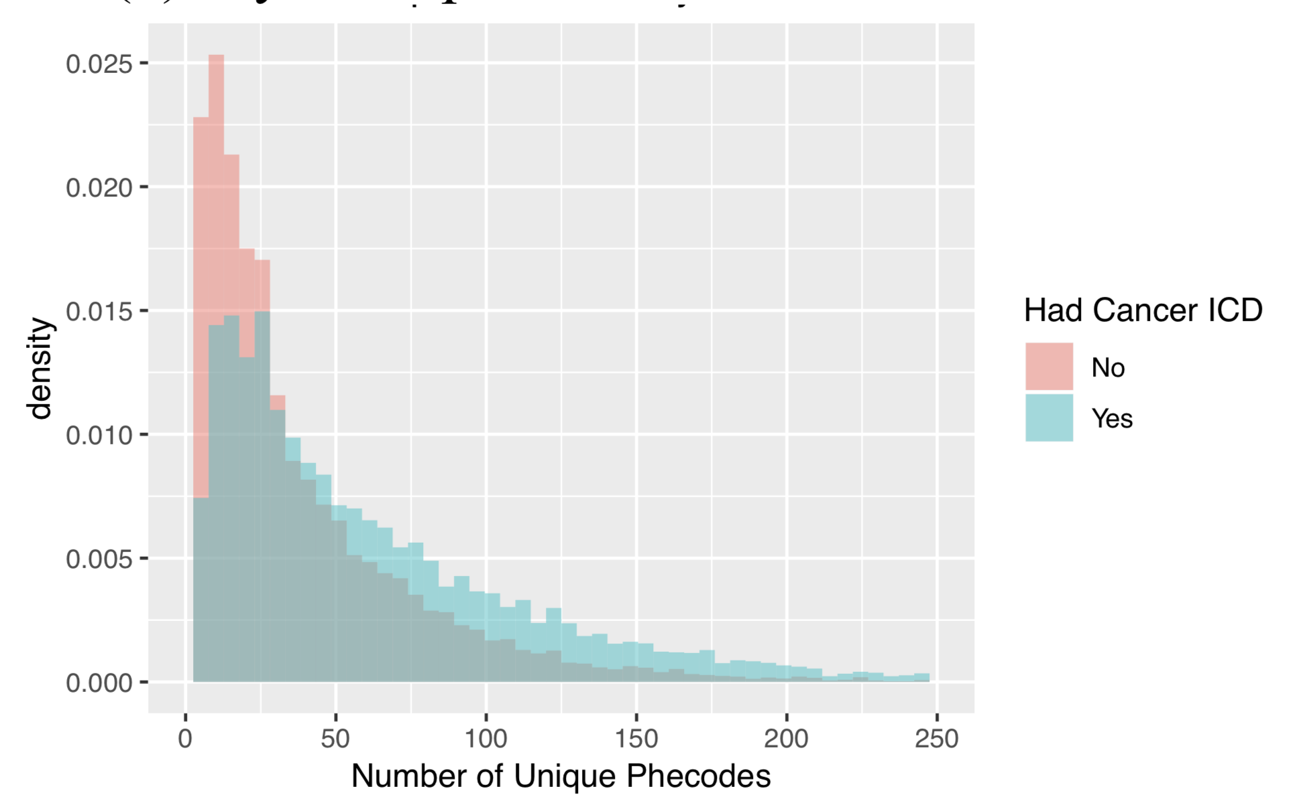
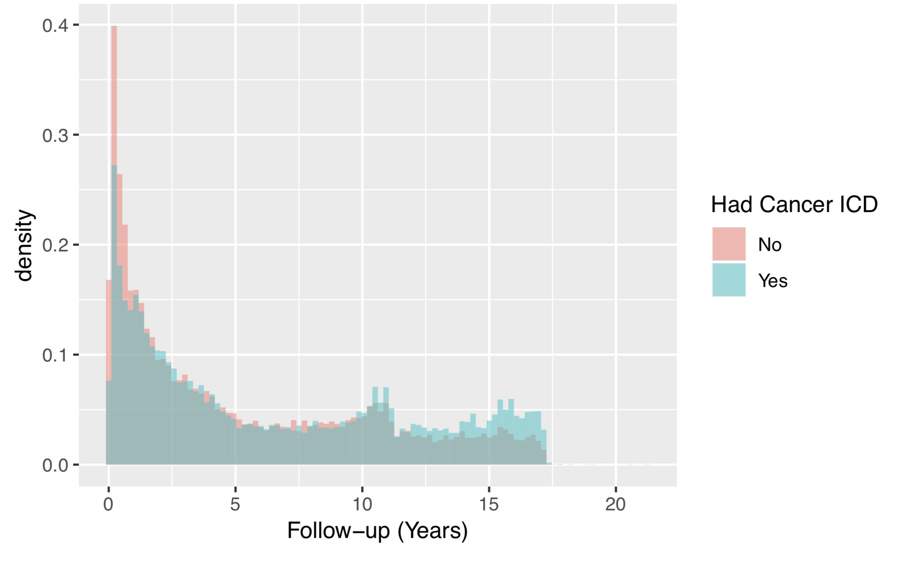
Misclassification Related to Follow-up?
Not clear whether we observe cancer diagnosis when subjects followed longer or subjects followed longer due to cancer diagnosis. Probably both.
Follow-up Time
# Visits
# Unique Diagnosis Codes
From Beesley et al. (2019)

Slide 40
Misclassification Probably Differs by Disease
Challenge for phenome-wide association studies (PheWAS)
Anxiety ICD Code
Heart Attack ICD Code

Slide 41
Selection may Relate to Unobserved Information
Patients decide whether to go to the hospital
May be related to underlying disease status
The observation mechanism not known
“Non-probabilistic sampling”
Subjects who visit a hospital are sicker than the average person on average
Want to generalize to some target population
e.g. U.S. population
May result in selection bias depending on goal analysis
?

Slide 42
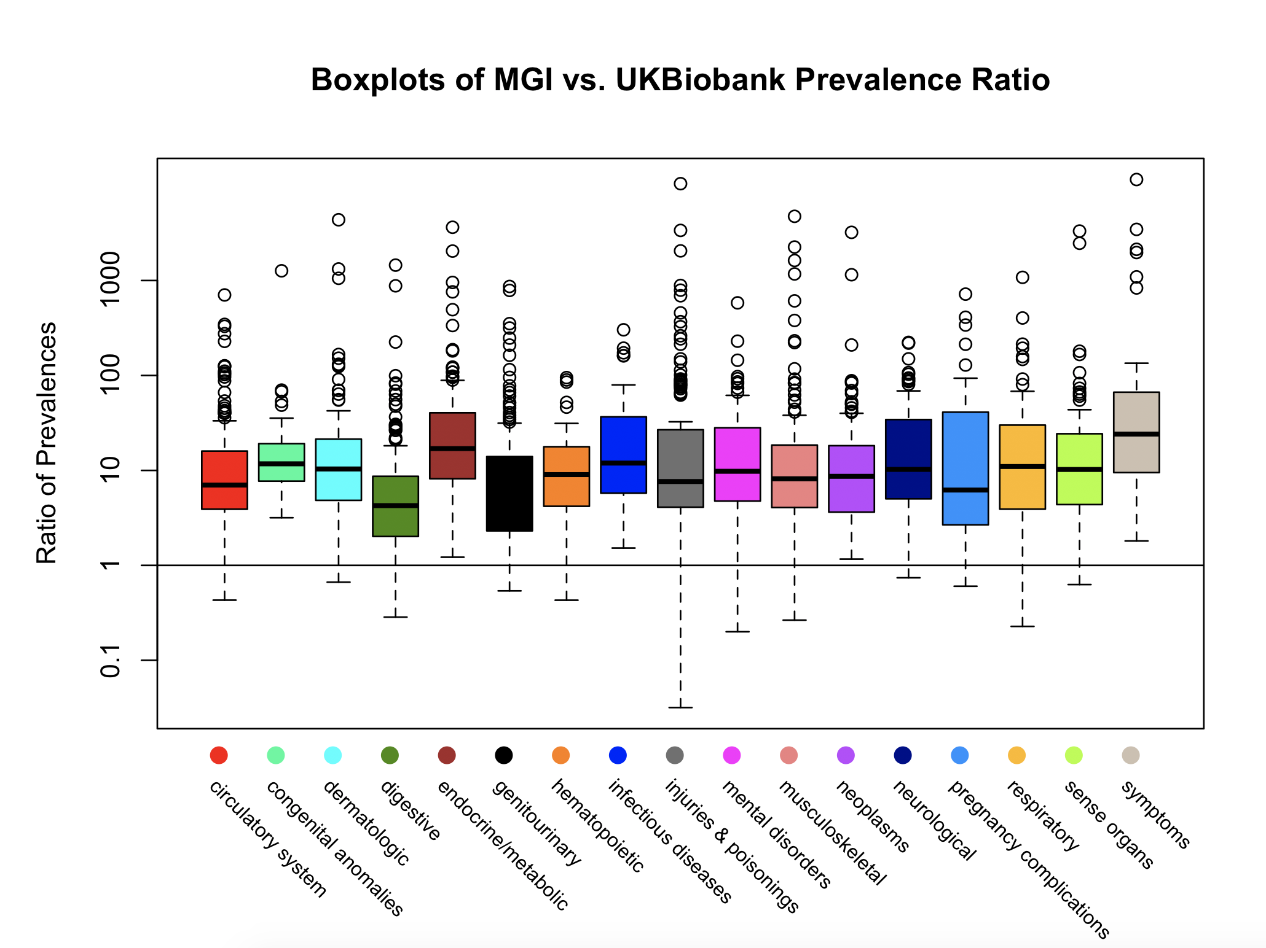
Comparison of MGI with UK Biobank (Population-Based)
Beesley et al, Under Review, 2019a

Slide 43
Snapshot of existing methods
Sample matching (design-based)
Match non-probability cases to control probability sample, often using propensity modelling
Choose cohort to match population distribution of gender, age, race, etc.
Other Propensity-based Methods
Using probability sample or some info on non-sampled subjects
Calibration Adjustments
Post-stratification, raking, generalized regression (GREG)
Weight analyses so that covariate distribution matches population or probability sample

Slide 44
These Biases Matter
Odds ratio between cancer diagnosis and gender (known association)

Slide 45



Conceptual Model
Beesley et al, under review
Latent Disease State
Sampled into MGI
Captured EHR Phenotype
S=0
D=1
D*=1
Birth
S=1
D*=0
D=0
S=0
D*=1
S=1
D*=0
Covariates
Recorded for S=1
G, Z
W, D
G, Z, X, Y
$$θ$$
$$φ$$
$$\tilde{θ}$$

Slide 46
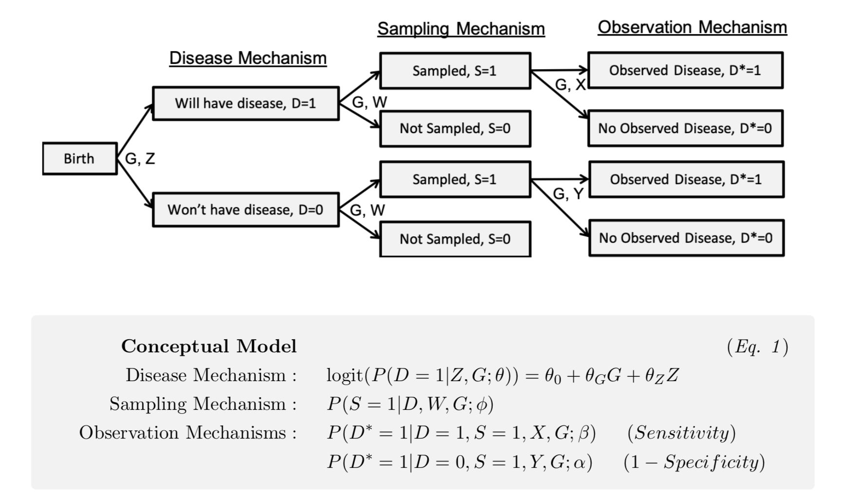
Models we pose (or impose)
Do not require parametric logistic models for sampling and observation
Make some assumptions of conditional independence

Slide 47
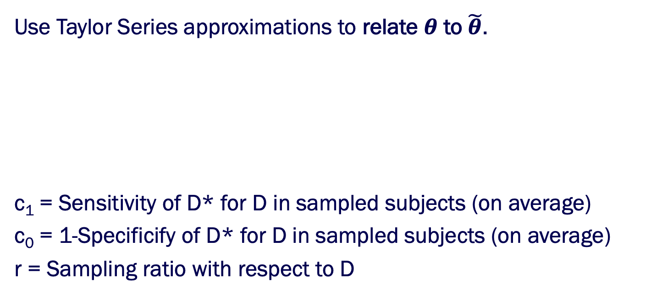
Relating Target Model and Analysis Model
Target Model:
Analysis Model:
Use Taylor Series approximations to relate $θ$ to $\tilde{θ}$.
c₁ = Sensitivity of D* for D in sampled subjects (on average)
c₀ = 1-Specificify of D* for D in sampled subjects (on average)
r = Sampling ratio with respect to D

Slide 48
Understanding Bias
Assume
sampling independent of D
Perfect specificity
Higher sampling ratio -> higher bias when D is misclassified
Larger impact of misclassification when disease is more common
http://shiny.sph.umich.edu/SAMBA-EHR/
Sampling Ratio = 1, c₀ = 0

Slide 49
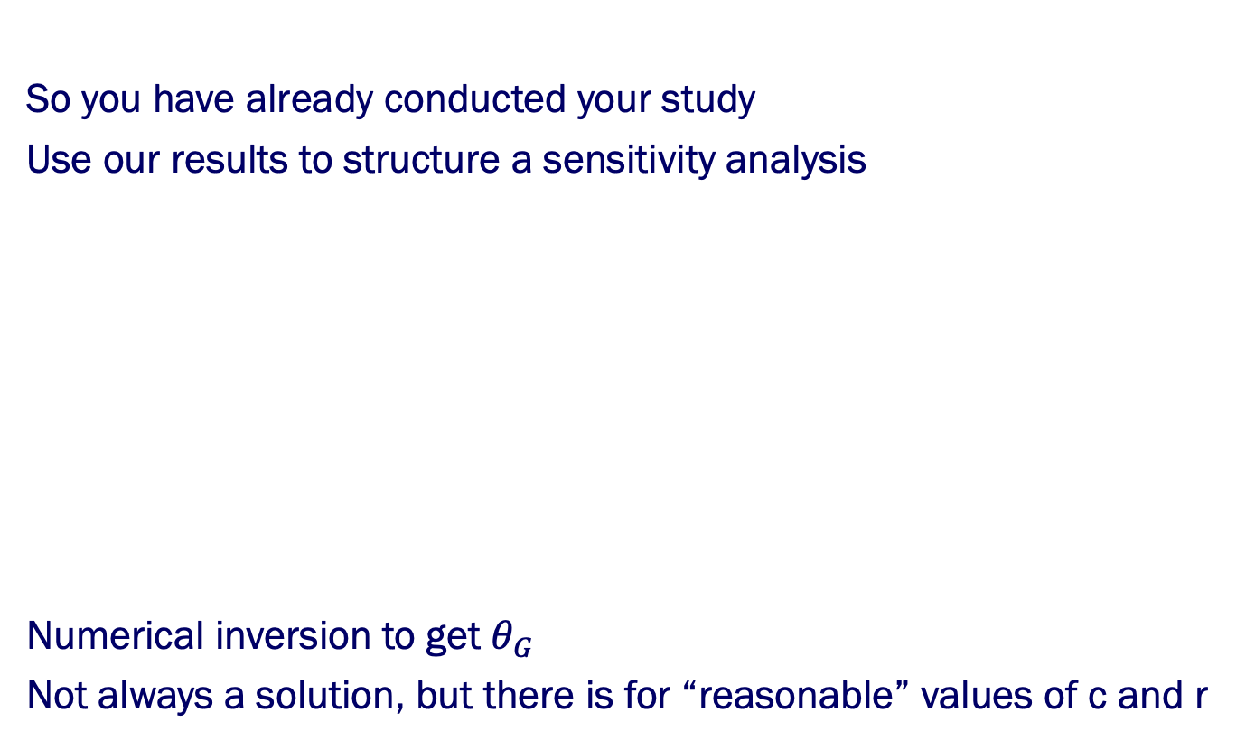
What about real data?
So you have already conducted your study
Use our results to structure a sensitivity analysis
Numerical inversion to get $θ_{G}$
Not always a solution, but there is for “reasonable” values of c and r
Have naïve estimate
and P(D=1)

Slide 50
Published Study Results
Fritsche et al, AJHG, 2018
Phenotype Description | N Cases | N Controls | GWAS Catalog SNPs | PRS Odd Ratio
Breast cancer [female] | 1,827 | 11,073 | 78 | 2.3 [2.0;2.7]
Cancer of prostate | 1,425 | 9,793 | 93 | 3.2 [2.7;3.9]
Melanomas of skin | 1,404 | 23,798 | 16 | 2.4 [2.0;2.8]
Basal cell carcinoma | 1,124 | 23,798 | 19 | 2.7 [2.2;3.2]
Cancer of bladder | 978 | 26,748 | 16 | 1.4 [1.2;1.7]
Non-Hodgkins lymphoma | 878 | 26,794 | 18 | 1.3 [1.1;1.6]
Colorectal cancer | 718 | 22,183 | 42 | 1.3 [1.1;1.6]
Squamous cell carcinoma | 703 | 23,798 | 5 | 2.0 [1.6;2.5]
Malignant neoplasm of kidney | 613 | 26,748 | 7 | 1.0 [0.8;1.3]
Lung cancer | 570 | 27,596 | 9 | 1.2 [0.9;1.6]
Thyroid cancer | 472 | 26,692 | 8 | 3.2 [2.5;4.5]
Cancer of brain & nervous system | 321 | 27,069 | 9 | 1.3 [0.9;1.7]

Slide 51
Sensitivity analysis of association with a polygenic risk score

Slide 52
Statistics in the era of data science

Slide 53
Forget the buzz word, do cool science without boundaries

Slide 54
New Explorers of New Horizons
The University of Michigan Big Data Summer Institute

Slide 55
Thank You!
Department of Biostatistics, University of Michigan
University of Michigan Rogel Cancer Center
NSF DMS 1712933, NIH CA 046592
Participants of MGI
University of Michigan, Precision Health Initiative

Slide 56
Questions?
?
?
?
?
?
?
?
?
?
?
?
?
?
?

Slide 57
References
Beesley LJ, Fritsche LG, Mukherjee B: A Modeling Framework for Exploring Bias in Phenome-Wide Association Studies. Published on bioarxiv (Under Review)
Beesley LJ, Salvatore M, Fritsche LG, Pandit A, Rao A, Brummett C, Willer CJ, Lisabeth LD, Mukherjee B: The Emerging Landscape of Epidemiological Research Based on Biobanks Linked to Electronic Health Records: Existing Resources, Analytic Challenges, and Potential Opportunities. Published on preprints.org. 2018. (Under Revision)
Duffy, S. W. et al. A simple model for potential use with a misclassified binary outcome in epidemiology. J. Epidemiol. Community Health 58, 712–717 (2004).
Fritsche L, Gruber SB, Wu Z, Schmidt EM, Zawistowski M, Moser SE, Blanc V, Brummet C, Kheterpal S, Abecasis GA, Mukherjee B. Association of Polygenic Risk Scores for Multiple Cancers in a Phenomewide Study: Results from The Michigan Genomics Initiative, The American Journal of Human Genetics, 102:1048-1061, 2018.
Huang, J. et al. PIE: A prior knowledge guided integrated likelihood estimation method for bias reduction in association studies using electronic health records data. J. Am. Med. Informatics Assoc. (2018). doi:10.1093/jamia/ocx137
Sinnott, J. A. et al. Improving the power of genetic association tests with imperfect phenotype derived from electronic medical records. Hum. Genet. 133, 1369–1382 (2014).

